Slide 1

Polytone
Group Members: Abdallah Abuhashem, Ammar AlQatari, Alejandrina Gonzales Reyes, Ahmed Shuaibi

Slide 2
Value Proposition +
Problem/Solution Overview
Display emotion through text.
We are tackling the problem of the inability to express various aspects of verbal communication (tone/volume/style/emotion) through text. By doing so, we directly address the issue of those who are completely deaf being incapable of obtaining an emotional context through basic text and captions they are often exposed to. We propose the solution of adding a different dimension to text and captions so that it may display emotion through manipulating the size, shape, and color of the text to correlate with the verbal communication.

Slide 3
Tasks
As a deaf student, I want to be able to visually understand tone, style, and volume of a lecture - simple.
I want to communicate with deaf people in 1-on-1 chats without the need to learn sign language - medium.
I want text to reflect my emotion and deliver it to other people so that they don’t necessarily need sound - medium.
As a teacher, I want to be able to able to easily add emotional meta-data that can be displayed visually to my verbal communication - complex.

Slide 4
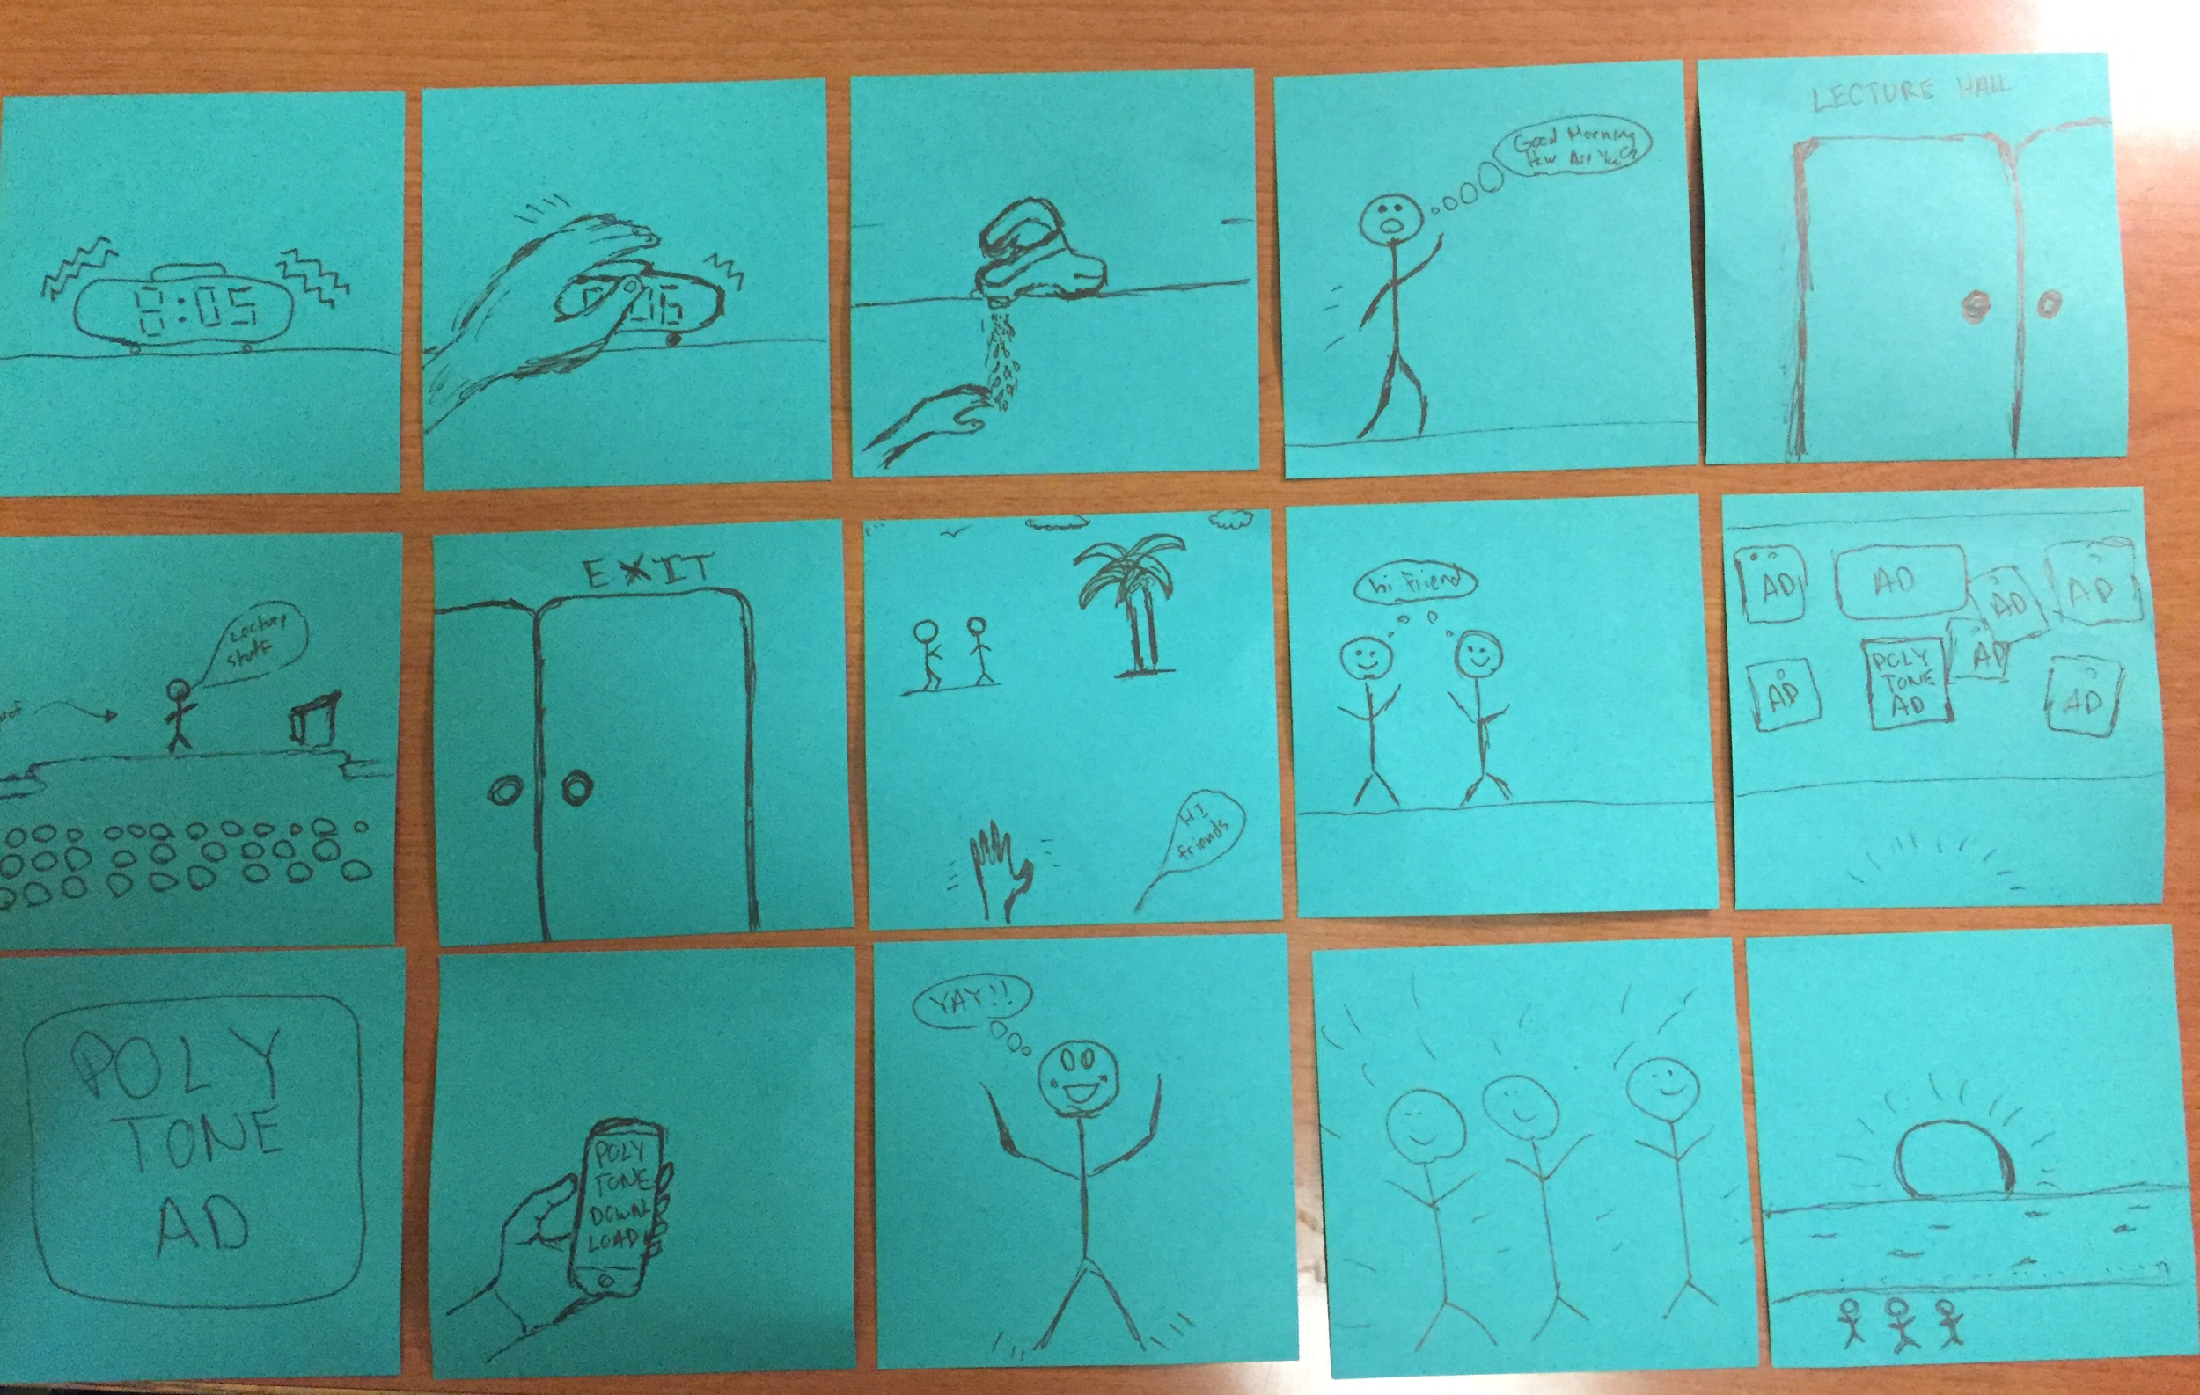
Storyboarding

Slide 5
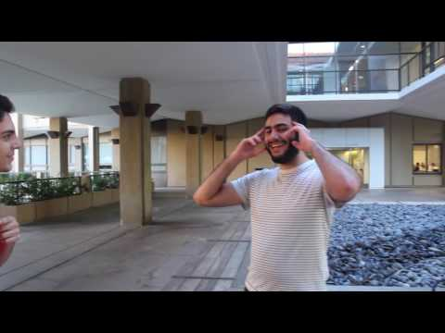
Video

